Slide 1

DEPARTMENT OF COMPUTER SCIENCE AND ENGINEERING
PROJECT Phase 1 – First Review
AI-Driven Multimodal Lecture Video Analysis and Intelligent Note Generation Platform
Team Members:
1. Mohan B - 23UCS102
2. Hemnath S - 23UCS065
3. Anas K - 23UCS013
Guide Name: Dr.N.Shanmugam
Associate Professor

Slide 2
Our Idea
Modern lectures involve multiple information sources such as spoken explanations, slides, and handwritten board content. Manually capturing all these simultaneously is difficult and often leads to incomplete and unstructured notes. This project is based on the idea of automatically generating accurate, structured lecture notes by leveraging AI-driven multi-modal processing of audio and visual inputs.
Existing Solutions
Abstract
Current note-taking and lecture transcription systems typically focus on a single modality, such as speech-to-text or slide-based extraction. These fragmented approaches fail to align spoken explanations with visual content and often produce disconnected or incomplete notes, especially in fast-paced or technical lectures.
Proposed Solution
The proposed AI-Powered Multi-Modal Lecture Note Generator integrates Automatic Speech Recognition, Optical Character Recognition, Computer Vision, and Natural Language Processing into a unified system. By temporally aligning audio and visual data and applying intelligent summarization, the system generates coherent, structured, and searchable lecture notes in real time.

Slide 3
Single-Modality Focus Most existing systems handle only one input type such as speech, slides, or images, leading to incomplete and disconnected lecture notes.
Accuracy Issues in Real Environments Speech recognition performance drops in noisy classrooms, with diverse accents, fast delivery, and domain-specific terminology, resulting in transcription errors.
Poor Visual Text Extraction OCR struggles with low-quality images, glare, handwritten board content, mixed layouts, and varying lighting conditions, reducing reliability.
Lack of Temporal Alignment Existing solutions fail to correctly align spoken explanations with corresponding slides or board content, causing loss of context and meaning.
Drawbacks of Existing Work
AI-Powered Multi-Modal Lecture Note Generator

Slide 4
Multi-Modal Data Capture The system captures lecture audio and visual content simultaneously, including spoken explanations, slides, and handwritten or printed board content.
Integrated AI Processing Speech recognition performance drops in noisy classrooms, with diverse accents, fast delivery, and domain-specific terminology, resulting in transcription errors.
Temporal Alignment and Fusion Outputs from multiple modalities are synchronized along a unified timeline to preserve context between spoken explanations and visual content.
Content Understanding and Structuring Natural Language Processing is applied to clean raw transcripts, remove redundancies, and organize information while preserving semantic meaning.
Proposed Solution
AI-Powered Multi-Modal Lecture Note Generator

Slide 5
Literature Survey
Sl. No. | Sub Domains | Papers Count | Advantages | Disadvantages
1 | Automatic Speech Recognition (ASR) | 3 | Slide-based LM adaptation improves ASR accuracy | Adaptation adds processing complexity and latency
2 | Optical Character Recognition (OCR) | 4 | Multi-scale recognition improves accuracy | More complex and resource-intensive
3 | Computer Vision (CV) | 4 | Details how YOLO models achieve real-time object detection. | Notes the trade-off between model recall and precision.
4 | Natural Language Processing (NLP) | 4 | Explores different machine learning methods for solving NLP problems | Highlights the challenge of data bias and the lack of model explainability
5 | Multi-Modal Information Fusion | 2 | Improves classification accuracy with multiple data types. | Limited by a small number of modalities and static data.
6 | Temporal Alignment | 2 | Proposes an efficient way to align video frames. | The method focuses on coarse, not fine-grained, alignment.

Slide 6
Input Processing Module
Content Understanding Module
Captures audio (lectures) and images.
Converts speech to text using ASR.
Extracts text from handwritten/printed notes using OCR.
Applies NLP to clean, summarize, and structure raw text.
Identifies key concepts, topics, and context.
Modules
Fusion & Alignment Module
Notes Generation Module
Integrates ASR, OCR, and CV outputs into a unified timeline.
Performs temporal alignment of lecture audio with visual notes.
Produces coherent, structured notes.
Highlights key takeaways and important concepts.
Exports notes in multiple formats (PDF, DOCX, etc.).

Slide 7
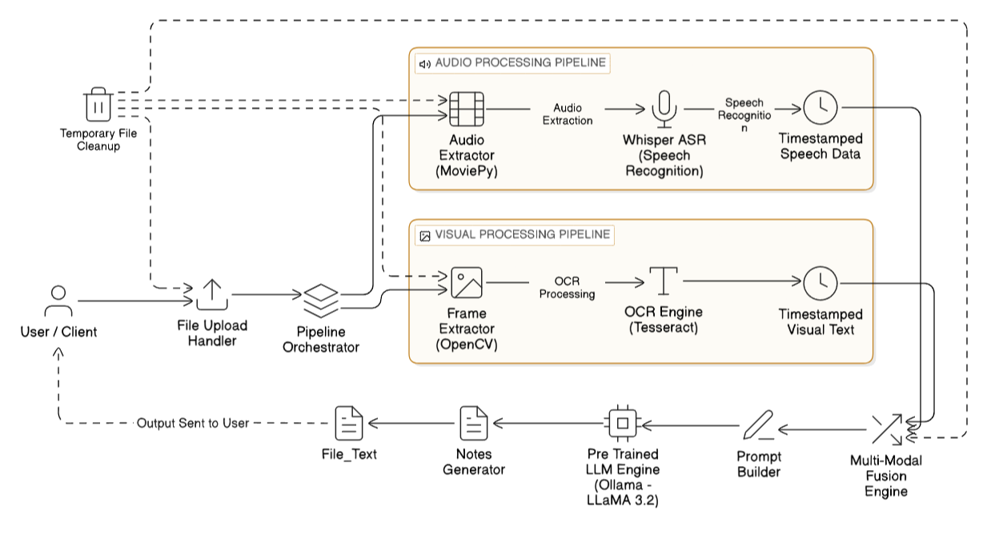
Architectural
diagram

Slide 8
Future Enhancements
Users could highlight and add comments to notes in a shared environment to identify key points of group interest.
The system could connect related concepts from multiple lectures, building a comprehensive knowledge map.
Real-time Collaboration and Highlights
Integration with Knowledge Graphs
Personalized Learning Paths
Sentiment and Emotion Analysis
Multi-Lingual Support
The system could adapt its notes and quizzes to a user's performance, providing a customized learning experience.
The AI could analyze the tone of voice to flag moments of confusion or emphasis in the lecture.
Notes could be automatically translated in real-time, making the tool accessible to a global audience.

Slide 9
The "AI-Powered Multi-Modal Lecture Note Generator" is a significant step forward in using AI to enhance learning. By seamlessly fusing live audio and visual content, the system acts as an intelligent assistant that automatically creates a structured, searchable record of any lecture or meeting.
Ultimately, this technology empowers users by reducing information overload and providing a foundation for improved comprehension and long-term knowledge retention.
Conclusion

Slide 10
Thank You

